Slide 1
Introduction to MTMEMAT1 Differential Geometry and Partial Differential Equations
Ulla-Lisbeth Hoffmann
ulh@mpe.au.dk
Office: 03.087

Slide 2
Schedule
Teaching takes place:
Wednesdays 8:00 – 09:45 and 10:15 – 12:00, except week 13
In weeks: 5 – 12 and 14 – 19
Usually in building 5125, room 408, Finlandsgade 22

Slide 3
Litterature
We are using lecture notes by Jürgen Schmiegel

Slide 4
Topics
Vector analysis
The Fourier series, Fourier integrals and Fourier transforms
Partial differential equations
One- and two-dimensional wave equations
Heat equations

Slide 5
Learning outcomes
Use vector functions to describe the motions of mechanical systems
Use transformations between double integrals and line integrals
Use transformations between volume integrals and surface integrals
Transform physical conditions into a mathematical model in the form of a partial differential equation
Master the different techniques of solving different types of partial differential equations, both analytical and numerical
Use the Fourier series to solve partial differential equations

Slide 6
How is it taught?
Theory
Examples
Exercises

Slide 7
Exam – how does it take place?
Oral exam on a set topic
The student can choose one of the topics below as the main exam topic.
But this does not mean that the other topics are not relevant, they are just minor exam topics. But note that these topics are all connected.
So you better prepare all of them and choose as your main topic the one you like most.
Vector Calculus
Vector Integral Calculus
Curves and Surfaces
Fourier Theory
PDEs (analytically)
PDEs (numerics)

Slide 8
Reexamination
Reexamination by appointment or in the next examination period

Slide 9
Vector Calculus
Lecture 1

Slide 10
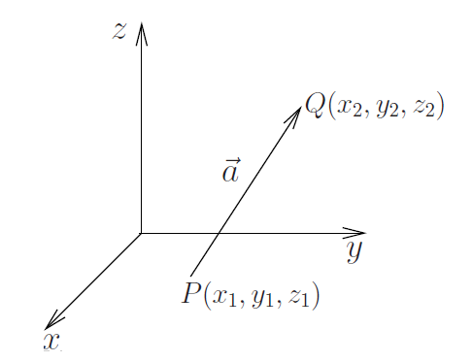
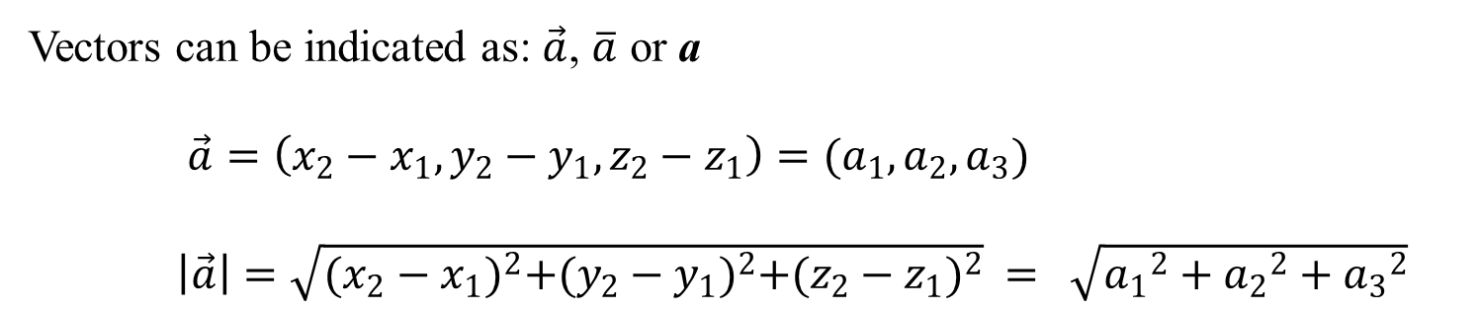
Definitions
A scalar a is described by its value. A scalar is simply a number
Fx. temperature, pressure, length, time, speed
A vector is described by its length and its direction
Fx. velocity, acceleration, force, the position in a coordinate system
Vectors can be indicated as: $\vec{a}$, $\overline{a}$ or a
$\vec{a}=\left(x_{2}−x_{1},y_{2}−y_{1},z_{2}−z_{1}\right)=(a_{1},a_{2},a_{3})$
$\left|\vec{a}\right|=\sqrt{{(x_{2}−x_{1})}^{2}+{(y_{2}−y_{1})}^{2}+{(z_{2}−z_{1})}^{2}} = \sqrt{{a_{1}}^{2}+{a_{2}}^{2}+{a_{3}}^{2}}$
J. Schmiegel: Lecture notes
The zero vector $\vec{0}$ is a vector with the length 0 and it has the coordinates (0,0,0)

Slide 11
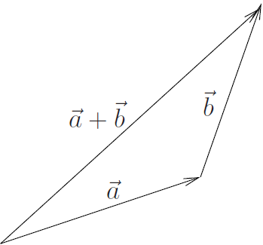
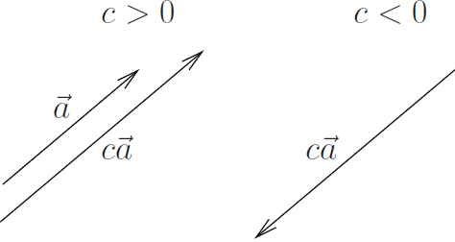
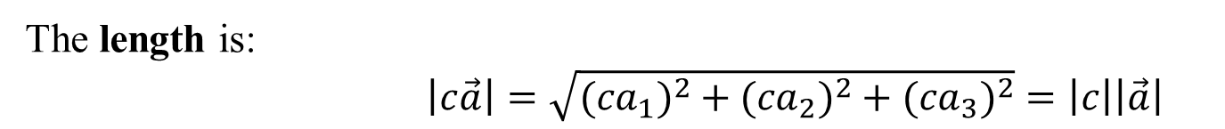
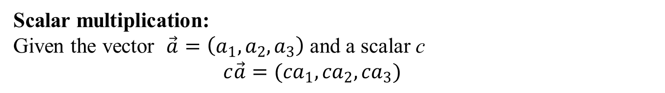
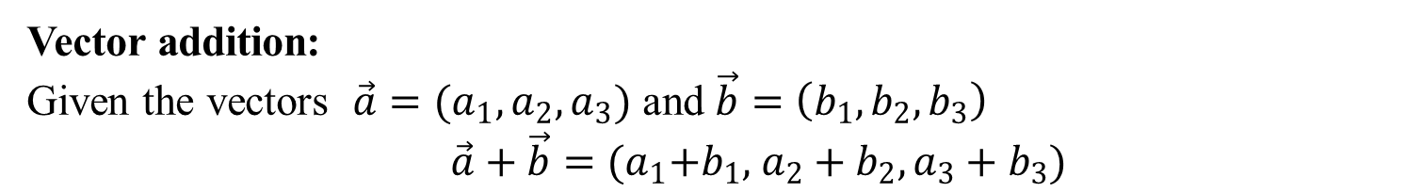
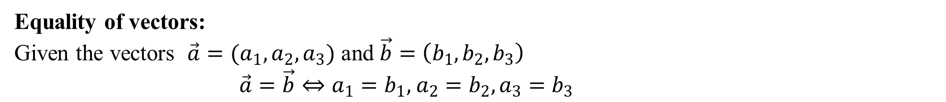
Vectors
Equality of vectors:
Given the vectors $\vec{a}=(a_{1},a_{2},a_{3})$ and $\vec{b}=\left(b_{1},b_{2},b_{3}\right)$
$\vec{a}=\vec{b}⇔a_{1}=b_{1},$ $a_{2}=b_{2},a_{3}=b_{3}$
Vector addition:
Given the vectors $\vec{a}=(a_{1},a_{2},a_{3})$ and $\vec{b}=\left(b_{1},b_{2},b_{3}\right)$
$\vec{a}+\vec{b}={(a}_{1}+b_{1},$ $a_{2}+b_{2},a_{3}+b_{3})$
J. Schmiegel: Lecture notes
Scalar multiplication:
Given the vector $\vec{a}=\left(a_{1},a_{2},a_{3}\right)$ and a scalar c
$c\vec{a}=({ca}_{1},{ca}_{2},{ca}_{3})$
The length is:
$\left|c\vec{a}\right|=\sqrt{{{{(ca}_{1})}^{2}+{(ca}_{2})}^{2}+{{(ca}_{3})}^{2}}=\left|c\right|\left|\vec{a}\right|$
J. Schmiegel: Lecture notes

Slide 12
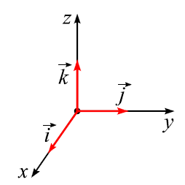
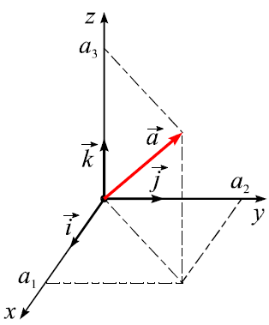
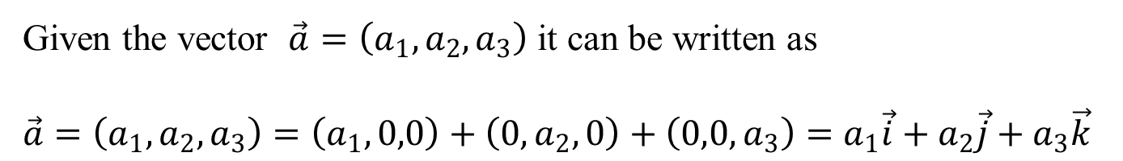
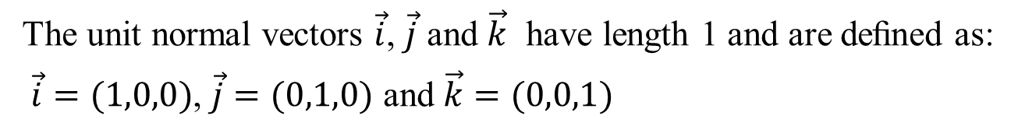
Unit normal vectors
The unit normal vectors $\vec{i}$, $\vec{j}$ and $\vec{k}$ have length 1 and are deﬁned as:
$\vec{i}=(1,0,0)$, $\vec{j}=(0,1,0)$ and $\vec{k}=(0,0,1)$
K. Bahr: Smart matematik A
Given the vector $\vec{a}=\left(a_{1},a_{2},a_{3}\right)$ it can be written as
$$\vec{a}=\left(a_{1},a_{2},a_{3}\right)=\left(a_{1},0,0\right)+\left(0,a_{2},0\right)+\left(0,0,a_{3}\right)=a_{1}\vec{i}+a_{2}\vec{j}+a_{3}\vec{k}$$
K. Bahr: Smart matematik A

Slide 13
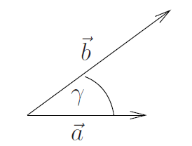
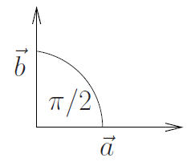

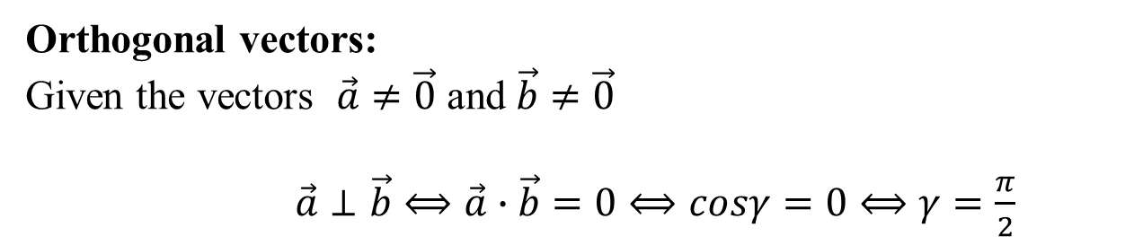
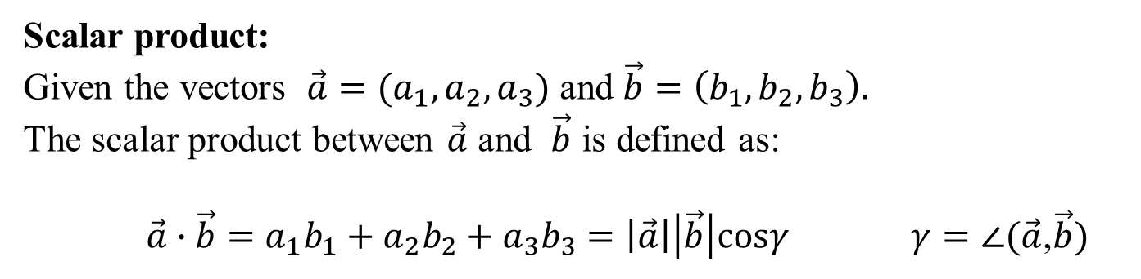
Vectors
Scalar product:
Given the vectors $\vec{a}=(a_{1},a_{2},a_{3})$ and $\vec{b}=\left(b_{1},b_{2},b_{3}\right).$
The scalar product between $\vec{a}$ and $\vec{b}$ is defined as:
$\vec{a}∙\vec{b}=a_{1}b_{1}+a_{2}b_{2}+a_{3}b_{3}=\left|\vec{a}\right|\left|\vec{b}\right|cosγ$ $γ=∠(\vec{a}$,$\vec{b})$
J. Schmiegel: Lecture notes
0$≤γ≤π$
Orthogonal vectors:
Given the vectors $\vec{a}≠\vec{0}$ and $\vec{b}≠\vec{0}$
$\vec{a}⊥\vec{b}⟺\vec{a}∙\vec{b}=0⟺cosγ=0⟺γ=\frac{π}{2}$
J. Schmiegel: Lecture notes

Slide 14
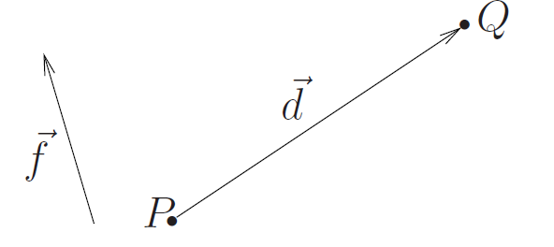
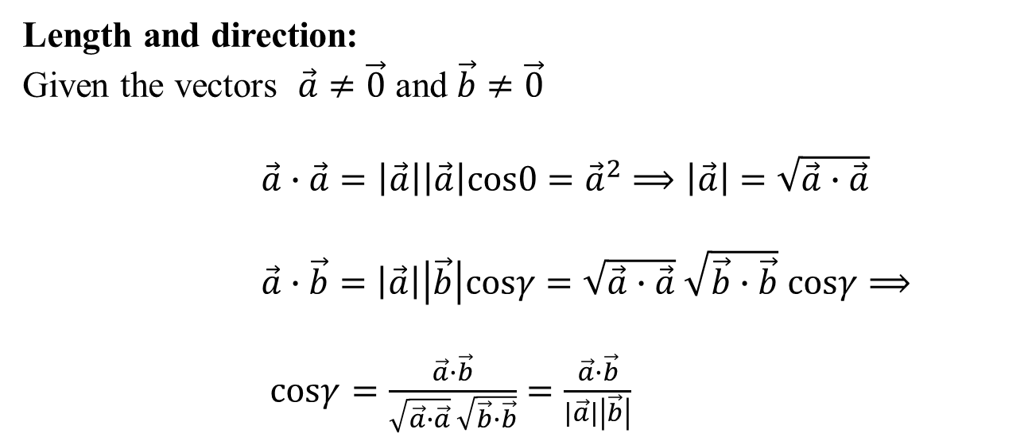
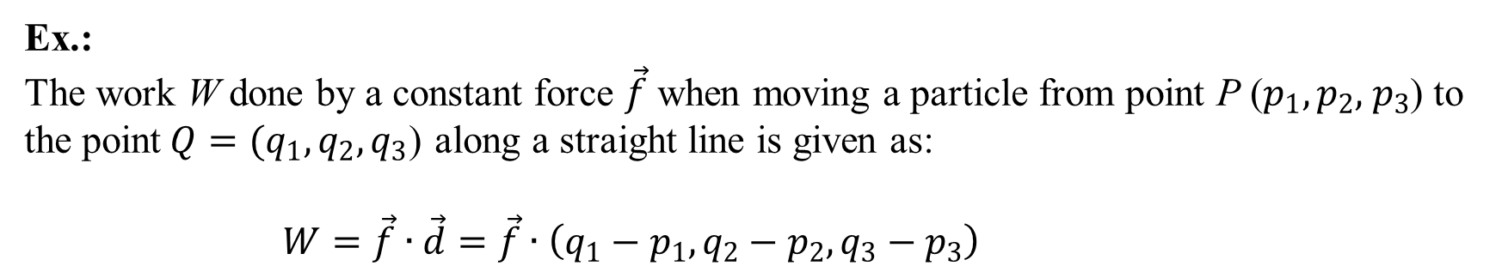
Vectors
Length and direction:
Given the vectors $\vec{a}≠\vec{0}$ and $\vec{b}≠\vec{0}$
$\vec{a}∙\vec{a}=\left|\vec{a}\right|\left|\vec{a}\right|cos0={\vec{a}}^{2}⟹\left|\vec{a}\right|=\sqrt{\vec{a}∙\vec{a}}$
$\vec{a}∙\vec{b}=\left|\vec{a}\right|\left|\vec{b}\right|cosγ=\sqrt{\vec{a}∙\vec{a}} \sqrt{\vec{b}∙\vec{b}}$ $cosγ$ $⟹$
$cosγ=\frac{\vec{a}∙\vec{b}}{\sqrt{\vec{a}∙\vec{a}} \sqrt{\vec{b}∙\vec{b}}}=\frac{\vec{a}∙\vec{b}}{\left|\vec{a}\right|\left|\vec{b}\right|}$
Ex.:
The work W done by a constant force $\vec{f}$ when moving a particle from point P ($p_{1},p_{2},$ $p_{3}$) to
the point${Q=(q}_{1},q_{2},q_{3}$) along a straight line is given as:
$W=\vec{f}∙\vec{d}=\vec{f}∙\left(q_{1}−p_{1},q_{2}−p_{2},q_{3}−p_{3}\right)$
J. Schmiegel: Lecture notes

Slide 15
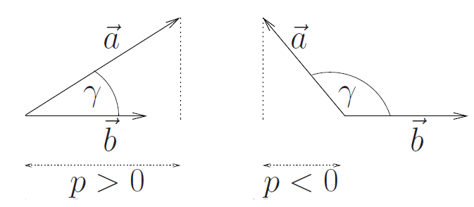
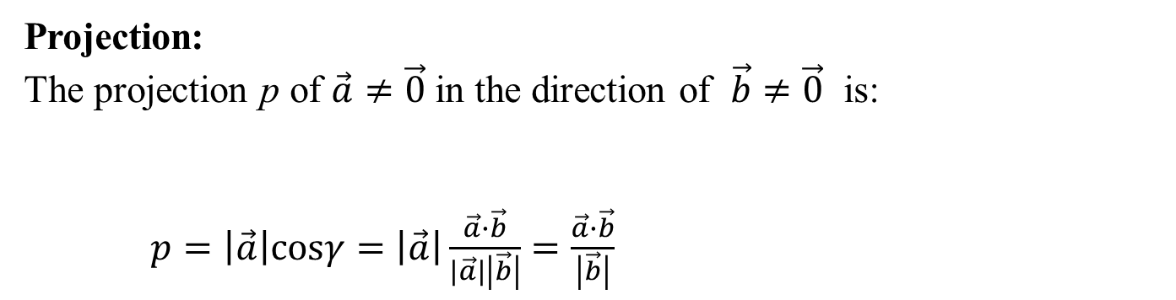
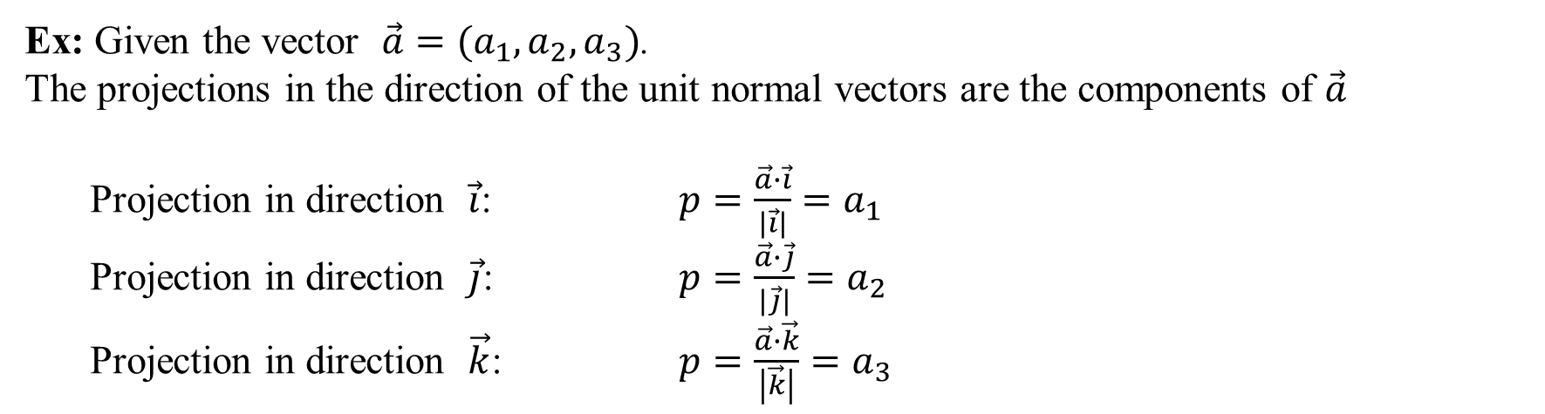
Vectors
Projection:
The projection p of $\vec{a}≠\vec{0}$ in the direction of $\vec{b}≠\vec{0}$ is:
$p=\left|\vec{a}\right|cosγ=\left|\vec{a}\right|\frac{\vec{a}∙\vec{b}}{\left|\vec{a}\right|\left|\vec{b}\right|}=\frac{\vec{a}∙\vec{b}}{\left|\vec{b}\right|}$
J. Schmiegel: Lecture notes
Ex: Given the vector $\vec{a}=(a_{1},a_{2},a_{3})$.
The projections in the direction of the unit normal vectors are the components of $\vec{a}$
Projection in direction $\vec{i}$: $p=\frac{\vec{a}∙\vec{i}}{\left|\vec{i}\right|}=a_{1}$
Projection in direction $\vec{j}$: $p=\frac{\vec{a}∙\vec{j}}{\left|\vec{j}\right|}=a_{2}$
Projection in direction $\vec{k}$: $p=\frac{\vec{a}∙\vec{k}}{\left|\vec{k}\right|}=a_{3}$
K. Bahr: Smart matematik A

Slide 16
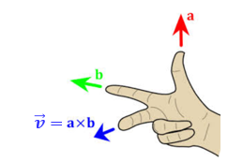
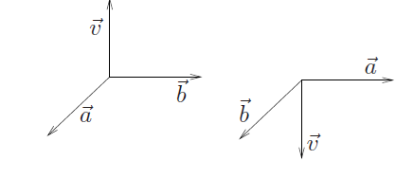
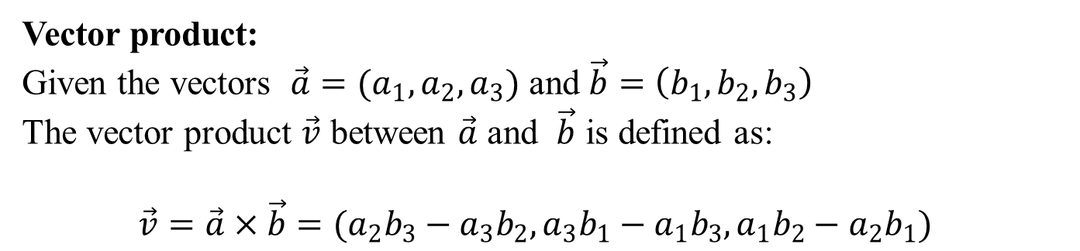
Vector product
Vector product:
Given the vectors $\vec{a}=(a_{1},a_{2},a_{3})$ and $\vec{b}=\left(b_{1},b_{2},b_{3}\right)$
The vector product $\vec{v}$ between $\vec{a}$ and $\vec{b}$ is defined as:
$\vec{v}=\vec{a}×\vec{b}={(a}_{2}b_{3}−a_{3}b_{2},a_{3}b_{1}−a_{1}b_{3},a_{1}b_{2}−a_{2}b_{1})$
The length of $\vec{v}$ is: $\left|\vec{v}\right|=\left|\vec{a}\right|\left|\vec{b}\right|sinγ$ $γ=∠(\vec{a}$,$\vec{b})$
The direction of $\vec{v}$ is: follows the right hand rule
J. Schmiegel: Lecture notes

Slide 17
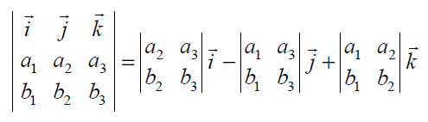
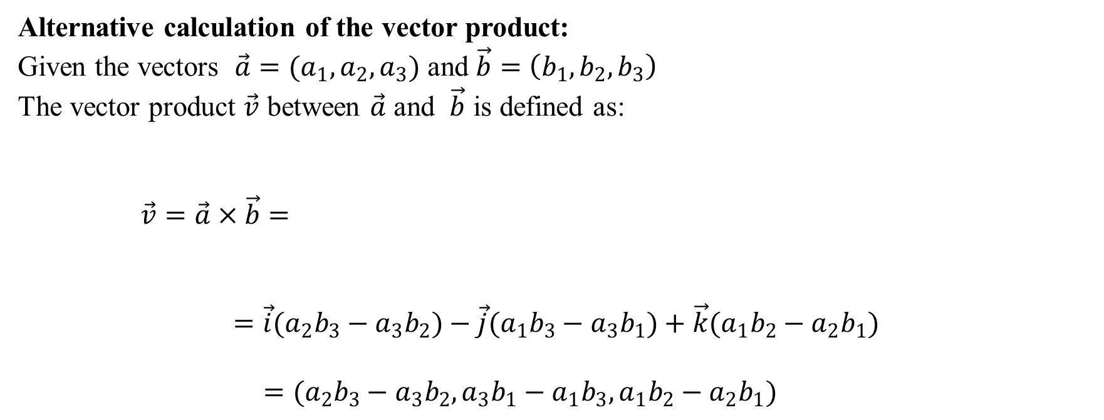
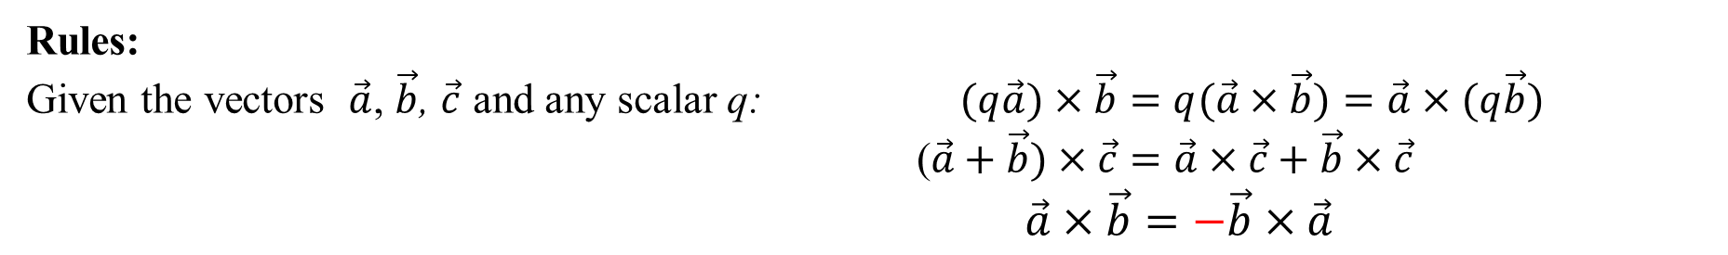
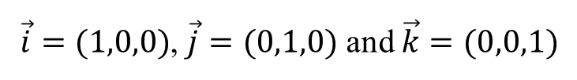
Vector product
Alternative calculation of the vector product:
Given the vectors $\vec{a}=(a_{1},a_{2},a_{3})$ and $\vec{b}=\left(b_{1},b_{2},b_{3}\right)$
The vector product $\vec{v}$ between $\vec{a}$ and $\vec{b}$ is defined as:
$\vec{v}=\vec{a}×\vec{b}=$
$$=\vec{i}{(a}_{2}b_{3}−a_{3}b_{2})−\vec{j}(a_{1}b_{3}−a_{3}b_{1})+\vec{k}(a_{1}b_{2}−a_{2}b_{1})$$
$={(a}_{2}b_{3}−a_{3}b_{2},a_{3}b_{1}−a_{1}b_{3},a_{1}b_{2}−a_{2}b_{1})$
$\vec{i}=(1,0,0)$, $\vec{j}=(0,1,0)$ and $\vec{k}=(0,0,1)$
Rules:
Given the vectors $\vec{a}$, $\vec{b}$, $\vec{c}$ and any scalar q: $(q\vec{a})×\vec{b}=q(\vec{a}×\vec{b})=\vec{a}×(q\vec{b})$
($\vec{a}+\vec{b})×\vec{c}=\vec{a}×\vec{c}+\vec{b}×\vec{c}$ $\vec{a}×\vec{b}=−\vec{b}×\vec{a}$

Slide 18
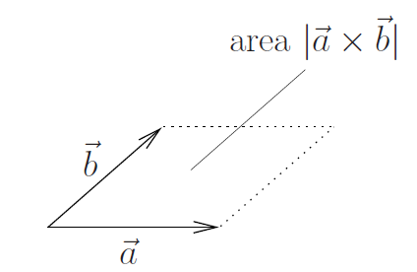
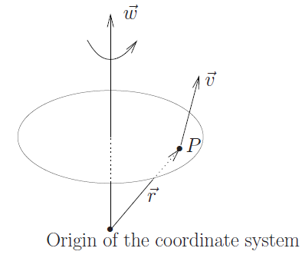

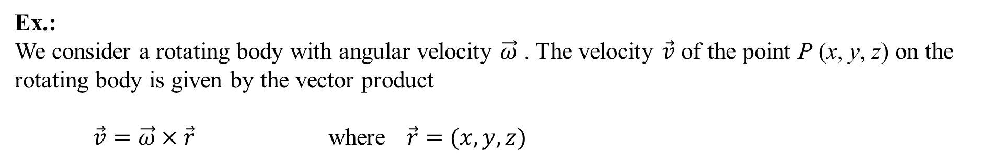
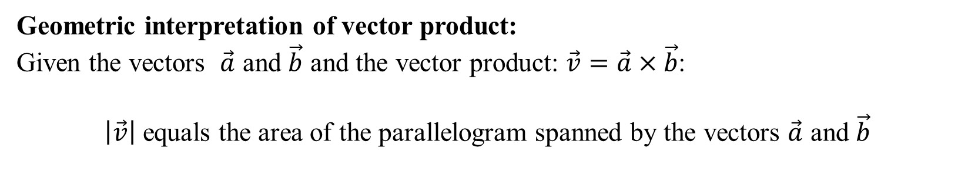
Vector product
Geometric interpretation of vector product:
Given the vectors $\vec{a}$ and $\vec{b}$ and the vector product: $\vec{v}=\vec{a}×\vec{b}$:
$\left|\vec{v}\right|$ equals the area of the parallelogram spanned by the vectors $\vec{a}$ and $\vec{b}$
$$\vec{v}$$
J. Schmiegel: Lecture notes
Ex.:
We consider a rotating body with angular velocity $\vec{ω}$ . The velocity $\vec{v}$ of the point P (x, y, z) on the rotating body is given by the vector product
$\vec{v}=\vec{ω}×\vec{r}$ where $\vec{r}=(x,y,z)$
J. Schmiegel: Lecture notes

Slide 19
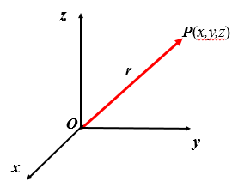
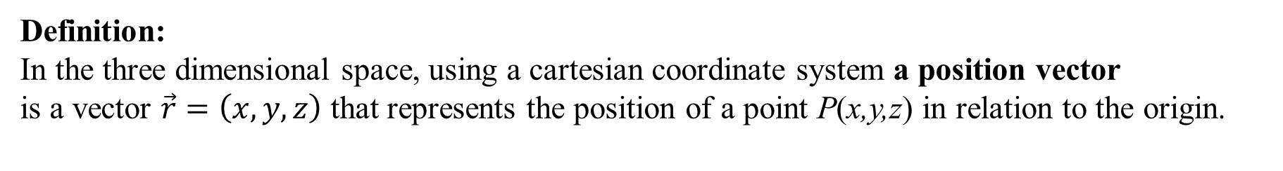
Position vector
Definition:
In the three dimensional space, using a cartesian coordinate system a position vector
is a vector $\vec{r}=\left(x,y,z\right)$ that represents the position of a point P(x,y,z) in relation to the origin.

Slide 20
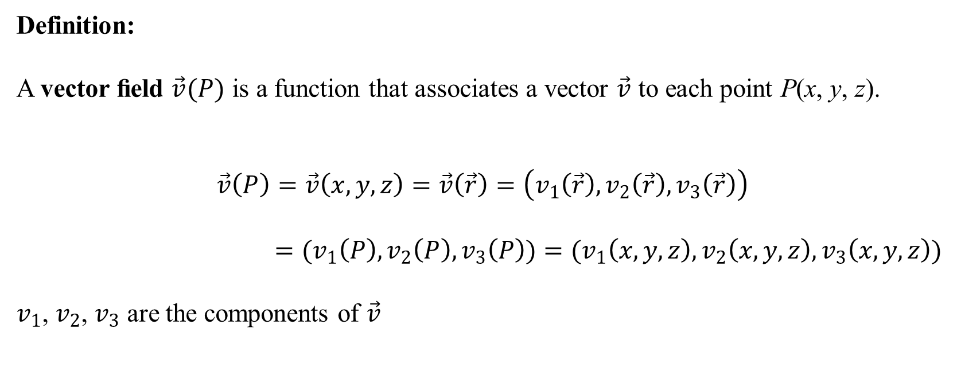
Vector functions and scalar functions
Definition:
A vector ﬁeld $\vec{v}(P)$ is a function that associates a vector $\vec{v}$ to each point P(x, y, z).
$$\vec{v}\left(P\right)=\vec{v}\left(x,y,z\right)=\vec{v}\left(\vec{r}\right)=\left(v_{1}\left(\vec{r}\right),v_{2}\left(\vec{r}\right),v_{3}\left(\vec{r}\right)\right)$$
$=(v_{1}\left(P\right),v_{2}\left(P\right),v_{3}\left(P\right))=(v_{1}\left(x,y,z\right),v_{2}\left(x,y,z\right),v_{3}\left(x,y,z\right))$
$v_{1}$, $v_{2}$, $v_{3}$ are the components of $\vec{v}$

Slide 21
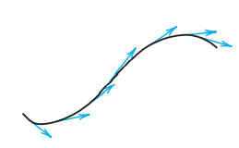
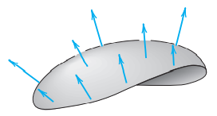
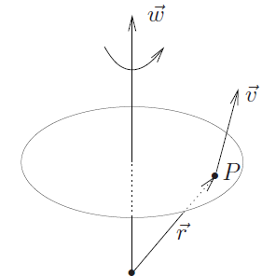
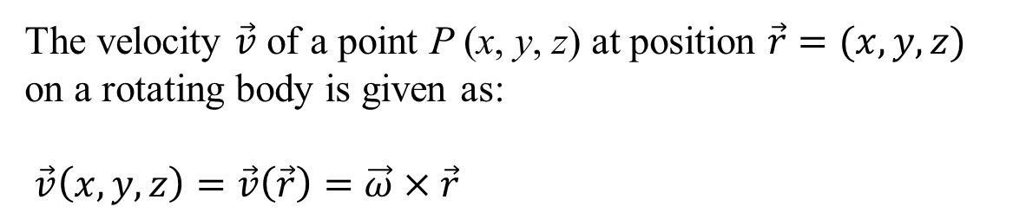
Vector functions and scalar functions
Ex of vector fields:
E. Kreyszig: Advanced Engeneering Mathematics
Field of tangent vectors of a curve
Field of normal vectors of a surface
The velocity $\vec{v}$ of a point P (x, y, z) at position $\vec{r}=(x,y,z)$
on a rotating body is given as:
$\vec{v}\left(x,y,z\right)=\vec{v}\left(\vec{r}\right)=\vec{ω}×\vec{r}$
J. Schmiegel: Lecture notes

Slide 22
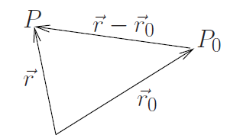
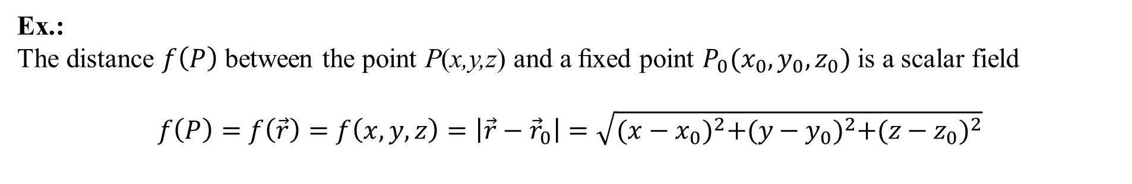
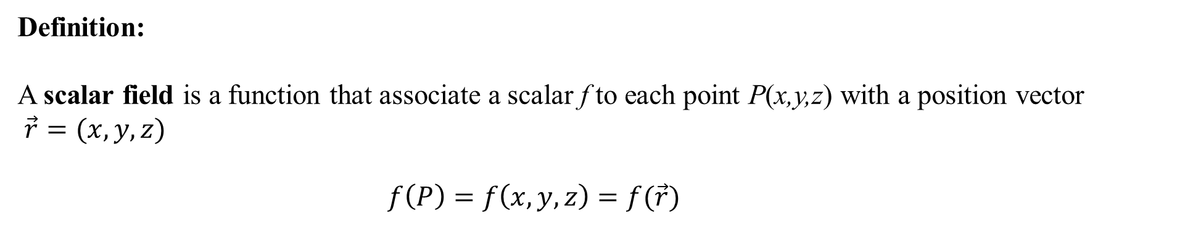
Vector functions and scalar functions
Definition:
A scalar field is a function that associate a scalar f to each point P(x,y,z) with a position vector
$\vec{r}=(x,y,z)$
$f\left(P\right)=f\left(x,y,z\right)=f(\vec{r})$
Ex.:
The distance $f\left(P\right)$ between the point P(x,y,z) and a ﬁxed point $P_{0}(x_{0},y_{0},z_{0})$ is a scalar field
$$f\left(P\right)=f\left(\vec{r}\right)=f\left(x,y,z\right)=\left|\vec{r}−{\vec{r}}_{0}\right|=\sqrt{{(x−x_{0})}^{2}+{(y−y_{0})}^{2}+{(z−z_{0})}^{2}}$$
J. Schmiegel: Lecture notes

Slide 23
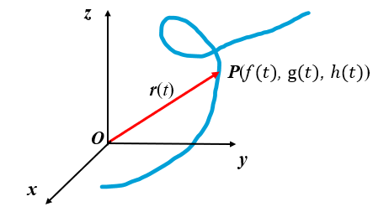
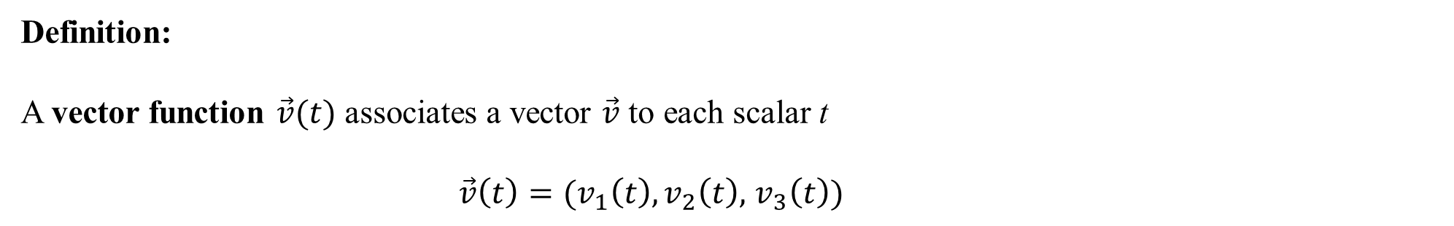
Vector functions and scalar functions
Definition:
A vector function $\vec{v}(t)$ associates a vector $\vec{v}$ to each scalar t
$\vec{v}\left(t\right)={(v}_{1}\left(t\right),v_{2}\left(t\right),$ $v_{3}\left(t\right))$
Ex.:
The velocity $\vec{v}\left(t\right)$ of the wind at a ﬁxed position and as a function of time t is a vector function.
Ex.:
Parametric representation of a curve in space for a particle moving through space during a time interval.

Slide 24
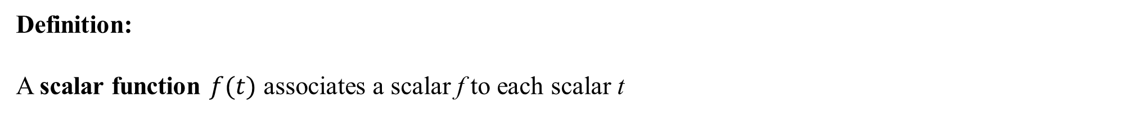
Vector functions and scalar functions
Definition:
A scalar function $f(t)$ associates a scalar f to each scalar t
Ex.:
The temperature T(t) at a ﬁxed position as a function of time t is a scalar function.

Slide 25
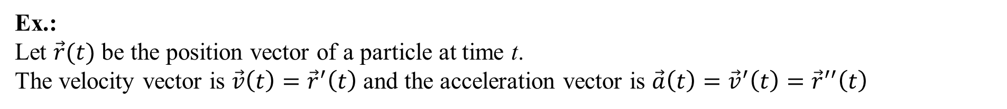
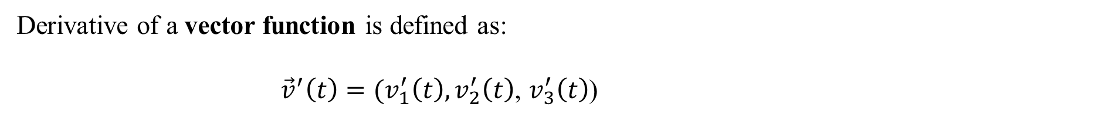
Derivatives of vector functions and scalar functions
Derivative of a scalar function $f^{′}(t)$ is the usual derivative
Derivative of a vector function is defined as:
${\vec{v}}^{′}\left(t\right)=(v_{1}^{′}\left(t\right),v_{2}^{′}\left(t\right)$, $v_{3}^{′}\left(t\right)$)
Ex.:
Let $\vec{r}(t)$ be the position vector of a particle at time t.
The velocity vector is $\vec{v}\left(t\right)={\vec{r}}^{′}\left(t\right)$ and the acceleration vector is $\vec{a}\left(t\right)={\vec{v}}^{′}\left(t\right)={\vec{r}}^{′′}\left(t\right)$

Slide 26
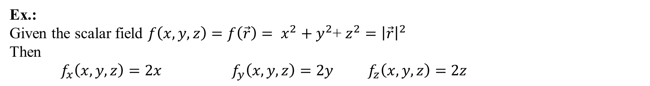
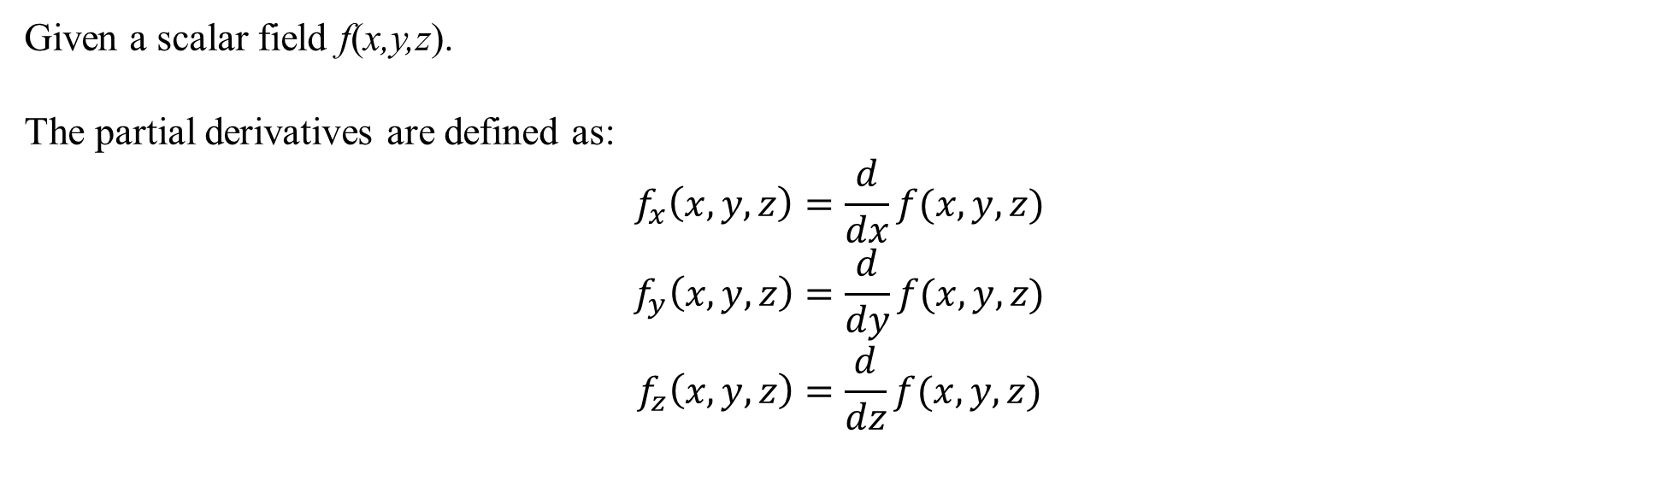
Partial derivatives of scalar field
Given a scalar field f(x,y,z).
The partial derivatives are defined as:
$$f_{x}\left(x,y,z\right)=\frac{d}{dx}f(x,y,z)$$
$$f_{y}\left(x,y,z\right)=\frac{d}{dy}f(x,y,z)$$
$$f_{z}\left(x,y,z\right)=\frac{d}{dz}f(x,y,z)$$
Ex.:
Given the scalar field $f\left(x,y,z\right)=f\left(\vec{r}\right)= x^{2}+y^{2}$+ $z^{2}={\left|\vec{r}\right|}^{2}$
Then
$f_{x}\left(x,y,z\right)=2x$ $f_{y}\left(x,y,z\right)=2y$ $f_{z}\left(x,y,z\right)=2z$

Slide 27


Partial derivatives of vector field
Given a vector field $\vec{v}(x,y,z)$.
The partial derivatives are defined as vectors of the partial derivatives of the components of $\vec{v}\left(x,y,z\right)$ :
$${\vec{v}}_{x}\left(x,y,z\right)=\left(\frac{d}{dx}v_{1}\left(x,y,z\right),\frac{d}{dx}v_{2}\left(x,y,z\right),\frac{d}{dx}v_{3}\left(x,y,z\right)\right)$$
$${\vec{v}}_{y}\left(x,y,z\right)=\left(\frac{d}{dy}v_{1}\left(x,y,z\right),\frac{d}{dy}v_{2}\left(x,y,z\right),\frac{d}{dy}v_{3}\left(x,y,z\right)\right)$$
$${\vec{v}}_{z}\left(x,y,z\right)=\left(\frac{d}{dz}v_{1}\left(x,y,z\right),\frac{d}{dz}v_{2}\left(x,y,z\right),\frac{d}{dz}v_{3}\left(x,y,z\right)\right)$$
Ex.: Given the vector field $\vec{v}\left(x,y,z\right)=\frac{1}{2}(x^{2},y^{2},z^{2})$
Then ${\vec{v}}_{x}\left(x,y,z\right)=(x,0,0)$ ${\vec{v}}_{y}\left(x,y,z\right)=(0,y,0)$ ${\vec{v}}_{z}\left(x,y,z\right)=(0,0,z)$

Slide 28





Curves
A curve C in space can be described by a parametric representation $\vec{r}\left(t\right).$
$\vec{r}(t)$ denotes the position vector of all points on the curve C.
t is a convenient variable that identiﬁes the points on C.
E. Kreyszig: Advanced Engeneering Mathematics
Ex.: Let C be a circle in the xy–plane with centre at the origin and radius R.
Then
$\vec{r}\left(t\right)=(x\left(t\right),y\left(t\right),z\left(t\right))=\left(Rcost,Rsint,0\right)$ $0≤t≤2π$
and
${\left|\vec{r}\left(t\right)\right|}^{2}={x\left(t\right)}^{2}+{y\left(t\right)}^{2}+{z\left(t\right)}^{2}=R^{2}\cos^{2}t+R^{2}\sin^{2}t+0^{2}=R^{2}$
$$\cos^{2}t+\sin^{2}t=1$$

Slide 29




Curves
Tangent of a curve C at the point $\vec{r}\left(t\right)$:
If the parametric representation $\vec{r}\left(t\right)$ of a given curve C is diﬀerentiable,
then ${\vec{r}}^{′}\left(t\right)$ is called the tangent at the point $\vec{r}\left(t\right)$.
The tangent deﬁnes the direction of a line L that touches
the curve C at the point $\vec{r}\left(t\right)$
J. Schmiegel: Lecture notes
Ex.: A circle in the xy–plane is given by: $\vec{r}\left(t\right)=\left(Rcost,Rsint,0\right)$,
Then
$r^{′}\left(t\right)=\left(−Rsint,Rcost,0\right)$
$r^{′}\left(0\right)=\left(−Rsin0,Rcos0,0\right)=(0,R,0)$
$r^{′}$($\frac{π}{2}$)$=\left(−Rsin\frac{π}{2},Rcos\frac{π}{2},0\right)=(−R,0,0)$
J. Schmiegel: Lecture notes

Slide 30


We are doing exercises from lecture notes 1

